Slide 1

A Presentation on Project Contactless Attendance System
Department of Computer Science and Engineering
Goel Institute of Technology and Management
Submitted to: Submitted By:
Mr. Yogendra Pratap Singh Asiya Sayed
Nilakshi Sahu

Slide 2
Contents
Problem Definition
Introduction
Computer Vision Technology
Face Detection
Face Recognition
Face Recognition Working
Applications of Face Recognition
Algorithms used
Objectives
Features and Drawbacks
11 . Level 0 DFD
12. Level 1 DFD
13. Level 2 DFD
14. Flowchart
15. Result Analysis
16. Future Scope
17. Project Snapshots

Slide 3
Problem Definition
Every organization has either a card punching attendance system or bio metric attendance system where it takes a bit longer when all employees gather to punch at the reporting time. In COVID times, it is really difficult to keep up with hygiene for the attendance system as all people touch the same surface. So it is really important to have a safety measure where it saves our time too.
Why don't we have a contactless attendance system where your face is identified for attendance ?

Slide 4
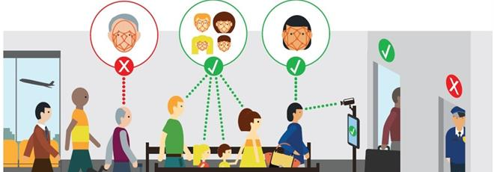
Project Description
Attendance of the employee is very important for every organization. Conventional methodology of taking attendance is by RFID card system, Fingerprint system, Voice recognition system. But it is easy for an employee to manipulate. To stay away from these losses, an automatic process is used in this project which is based on image processing.

Slide 5
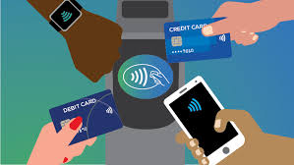
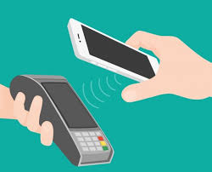
‘‘CONTACTLESS’’
Covid Period was and is still a challenge for people . Since the main cause for spread of the virus was contact , so people started looking for contacless ways in order to be safe, like using online payment option instead of cash , using personal conveyance in place of public transport etc. just to avoid contact.
Our Project is also a minor solution to the covid challenges faced by people

Slide 6

Computer vision technology
Computer vision is a field of artificial intelligence (AI) that enables computers and systems to derive meaningful information from digital images, videos and other visual inputs — and take actions or make recommendations based on that information.

Slide 7
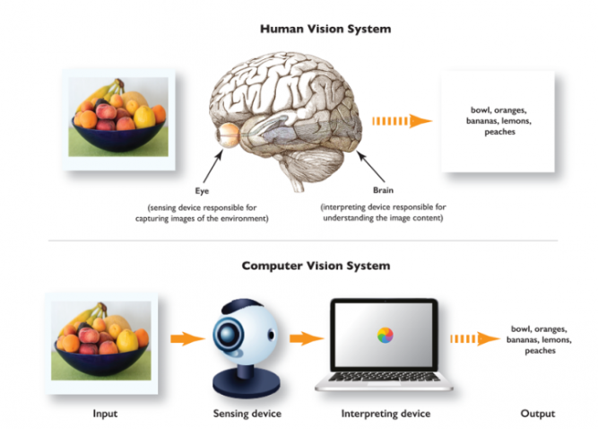
DIFFERENCE B/W HUMAN VISION &
COMPUTER VISION

Slide 8
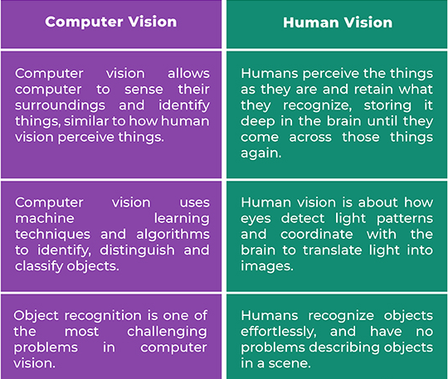
DIFFERENCE B/W HUMAN VISION &
COMPUTER VISION

Slide 9

What is Face Detection?
Face detection is a type of computer vision technology that is able to identify people’s faces within digital images.
Face detection is the process of identifying and locating all the present faces in a single image or video regardless of their position, scale, orientation, age and expression.

Slide 10
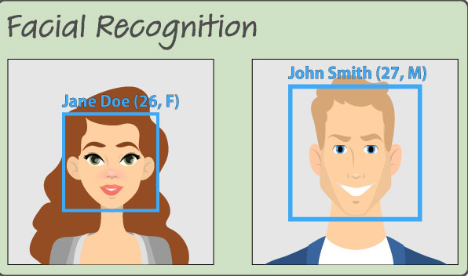
What is Face Recognition?
Face recognition is a visual pattern recognition problem, where the face, is represented as a three dimensional object that is subject to varying illumination, pose and other factors, Face recognition is therefore simply the task of identifying an already detected face as a known or unknown face and in more advanced cases telling exactly whose face it is.

Slide 11
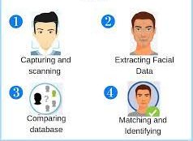
How does a Facial Reconition works ?

Slide 12
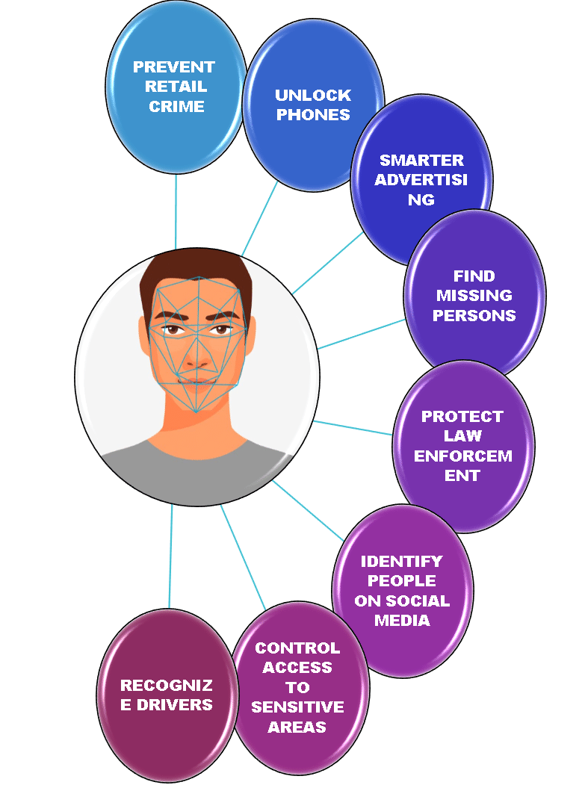
APPLICATIONS OF FACE RECOGNITION

Slide 13
ALGORITHMS USED IN THE PROJECT
LOCAL BINARY PATTERNS HISTOGRAM (LBPS)
2. HAAR CASCADE

Slide 14
Local Binary Patterns Histogram
Local binary pattern (LBP) is a face recognition algorithm used to recognize the face of a person. It is known for its performance and how it is able to recognize the face of a person from both front and side face.
LBPH algorithm work in 5 steps:
Parameters: The LBPH uses 4 parameters namely
Radius, Neighbors, Grid X and Grid Y.
2. Training the algorithm
3. Applying the LBP operation
4. Extracting the Histograms
5. Performing the face recognition

Slide 15
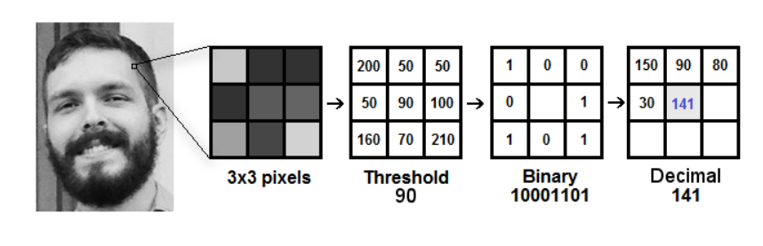
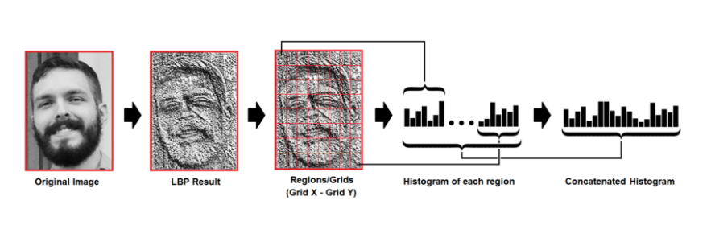
Local Binary Patterns Histogram
Fig 1
Fig 2

Slide 16
Haar Cascade
It is an object detection algorithm used to identify faces in an image or a real time video.
This algorithm uses edge or line detection features proposed by Viola and Jones.
Haar Cascade is a machine Leaning based approach where a lot of positive and negative images are used to train the classifier.

Slide 17
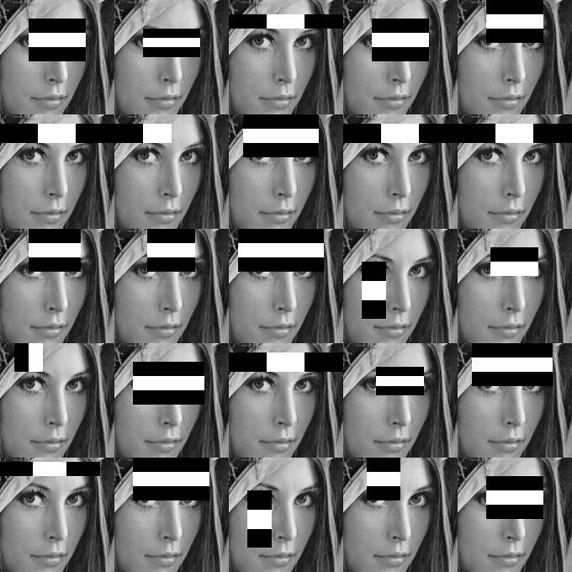
Haar Cascade

Slide 18
Objectives
The objective of this project is to develop face recognition attendance system. Expected achievements in order to fulfill the objectives are:
To detect the face segment from the video frame.
To extract the useful features from the face detected.
To classify the features in order to recognize the face detected.
To record the attendance of the identified employee.

Slide 19
Features and Drawbacks
FEATURES:
This system stores the faces that are detected and automatically marks attendance.
Easy to use as it manipulates and recognizes the faces in real time.
Multipurpose software, as it can be used in different places for different purposes.
DRAWBACKS:
The accuracy of this system is not 100%. It can only detect face from a limited distance.

Slide 20
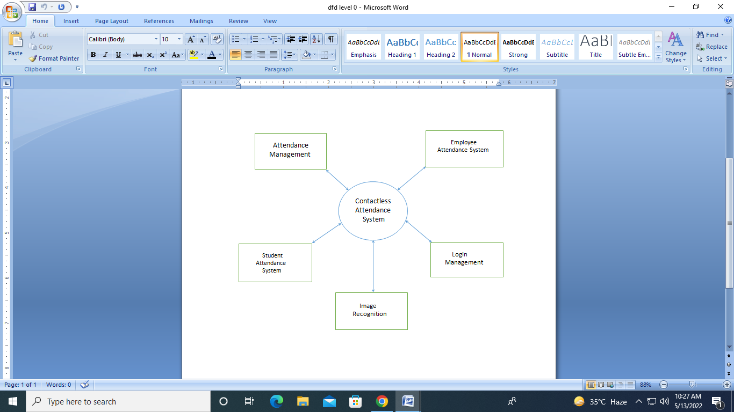
LEVEL - 0 DATA FLOW DIAGRAM

Slide 21
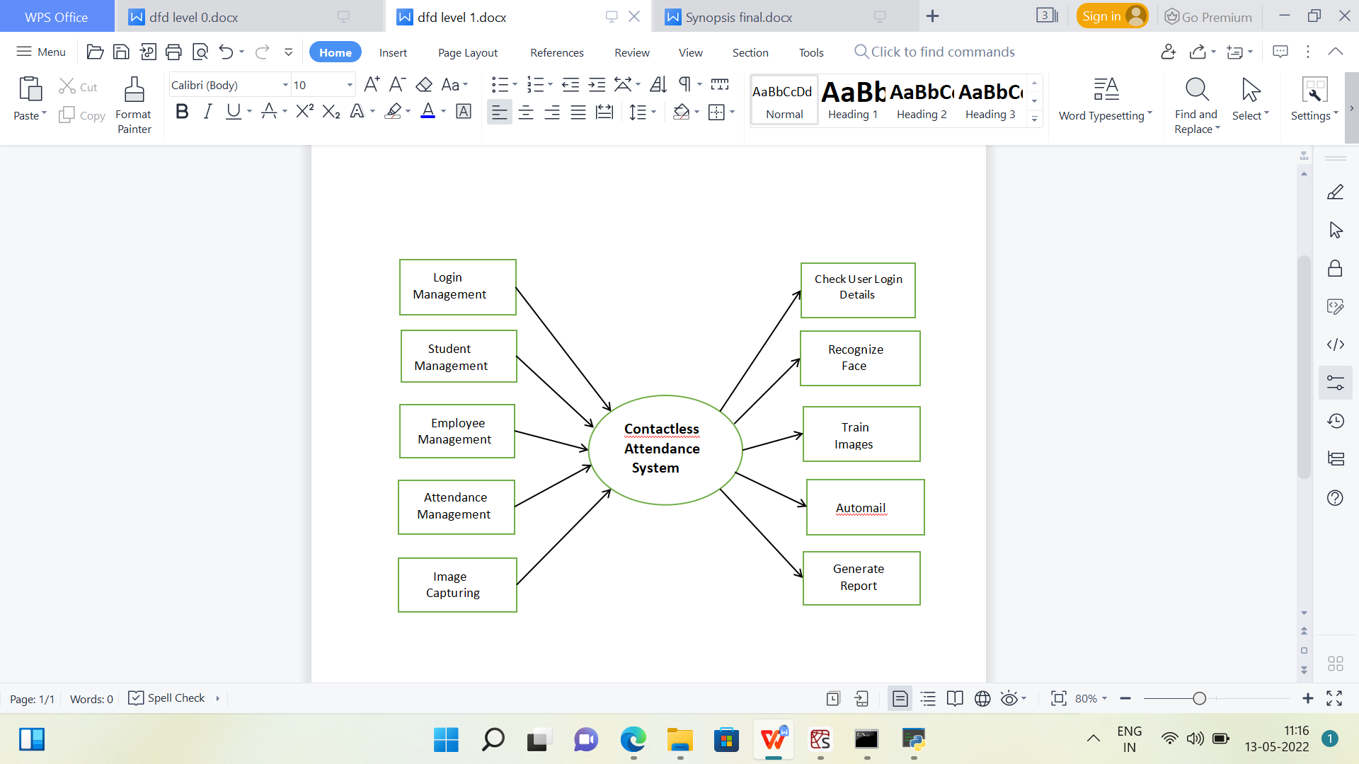
LEVEL - 1 DATA FLOW DIAGRAM

Slide 22
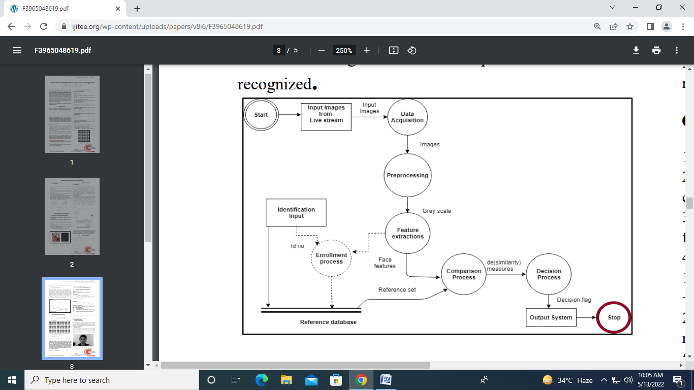
LEVEL - 2 DATA FLOW DIAGRAM

Slide 23

Library Used
OpenCV (Open Source Computer Vision Library)
OpenCV Python is an open –source library , which is used on computer vision in Artificial Intelligence, Machine Learning, Face Recognition etc.

Slide 24
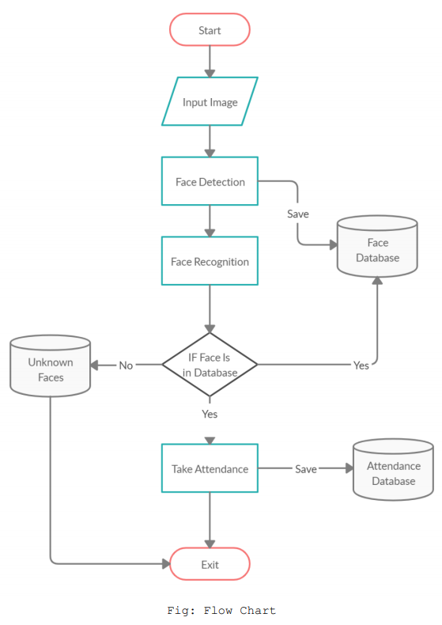
Flowchart

Slide 25
Result analysis
In this project face detection and face recognition is used.
The database of all the employee in the company is stored and when the face of the individual employee matches with one of the faces stored in the database then the attendance is recorded with precise time of entry.
We have worked on more than 120 pictures and it has resulted in approximately 70-75% of accuracy.

Slide 26
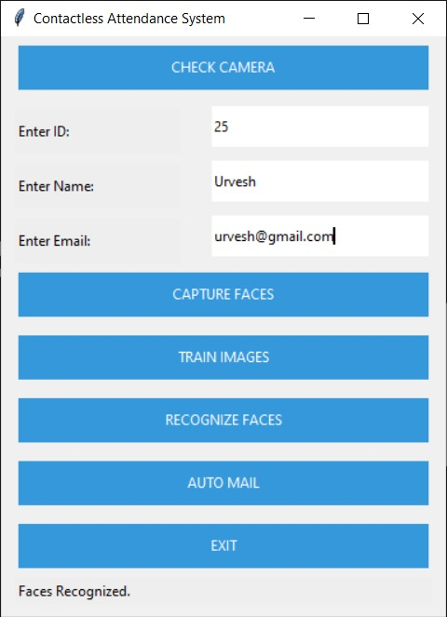
Project Snapshots

Slide 27
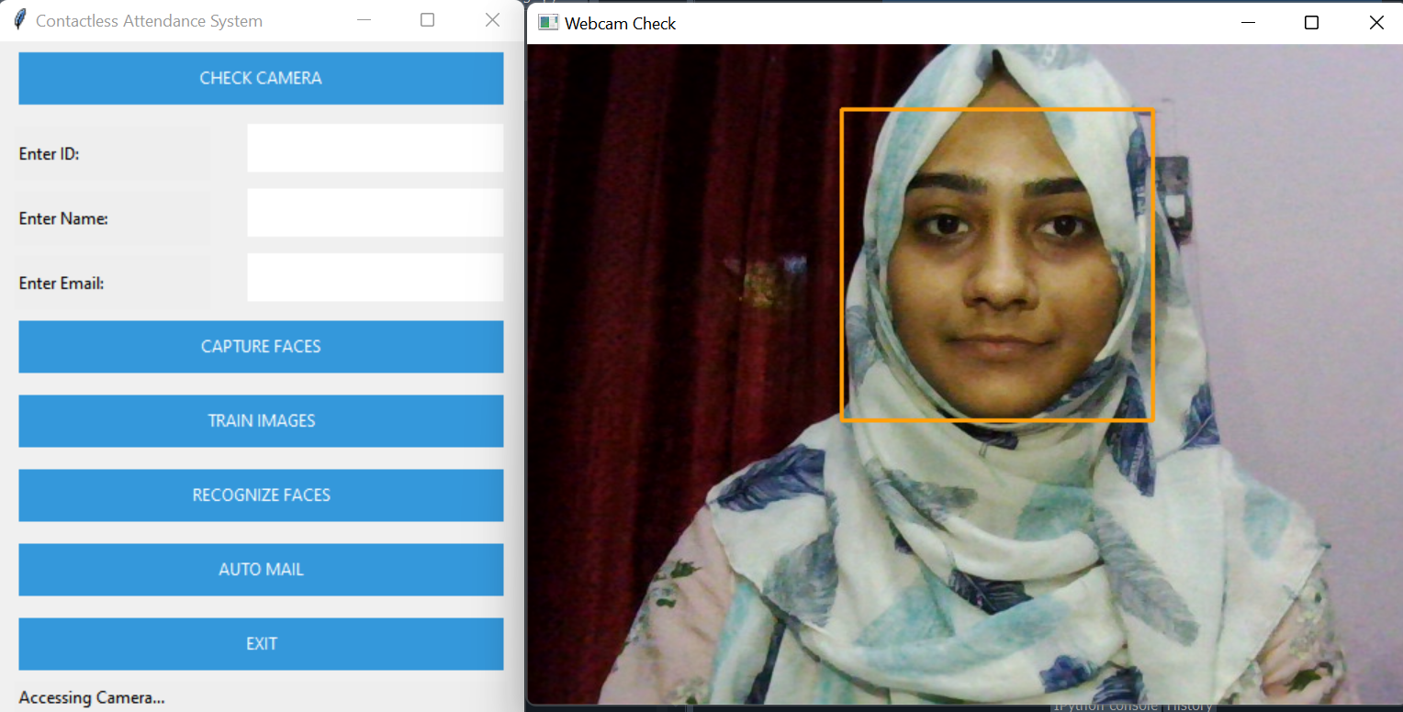
Project Snapshots

Slide 28
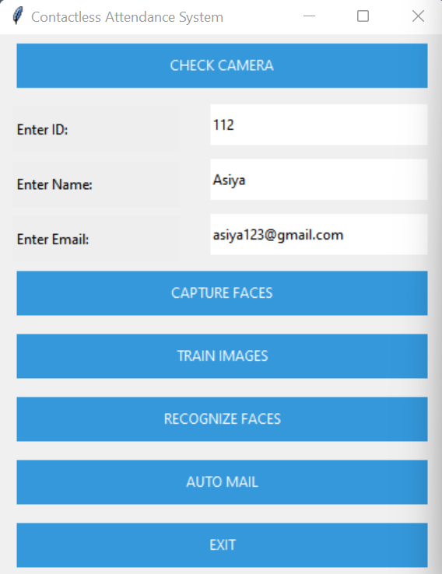
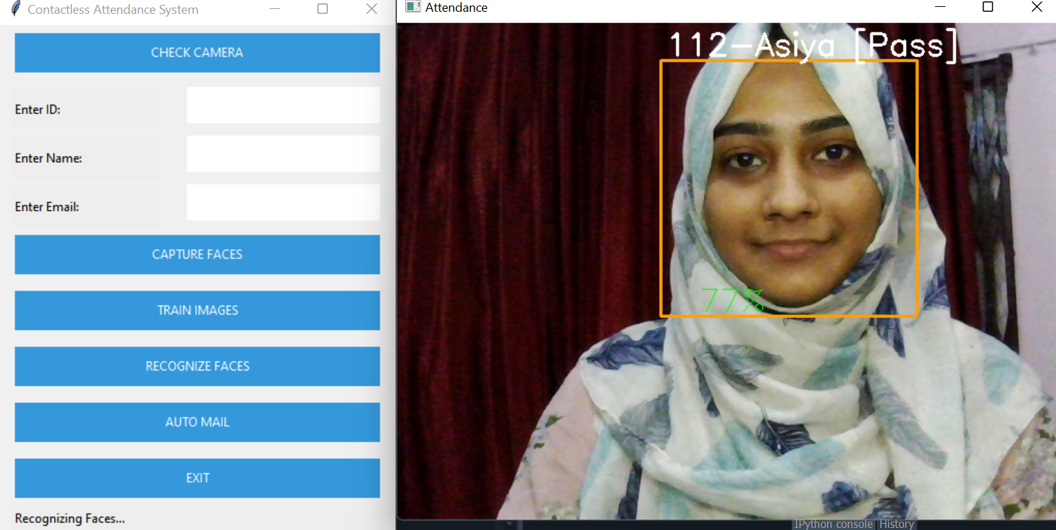
Project Snapshots

Slide 29
Future Scope
Can improve security.
Can use Neural Network for high accuracy
Can be used in big factory or for student attendance.
Can build on fully web base system.

Slide 30


